Slide 1
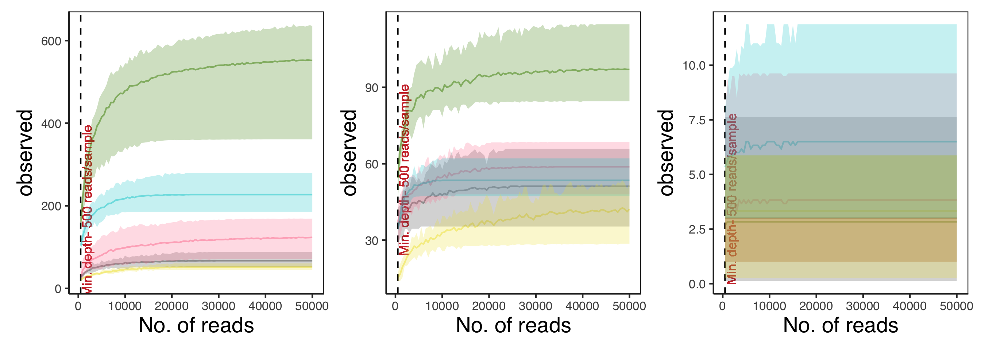
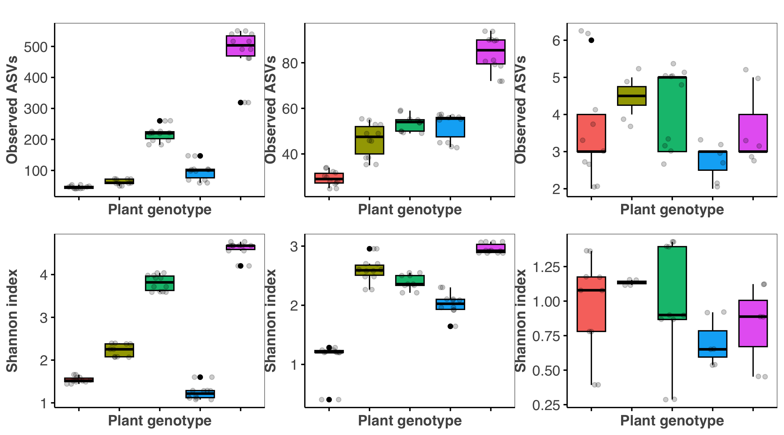
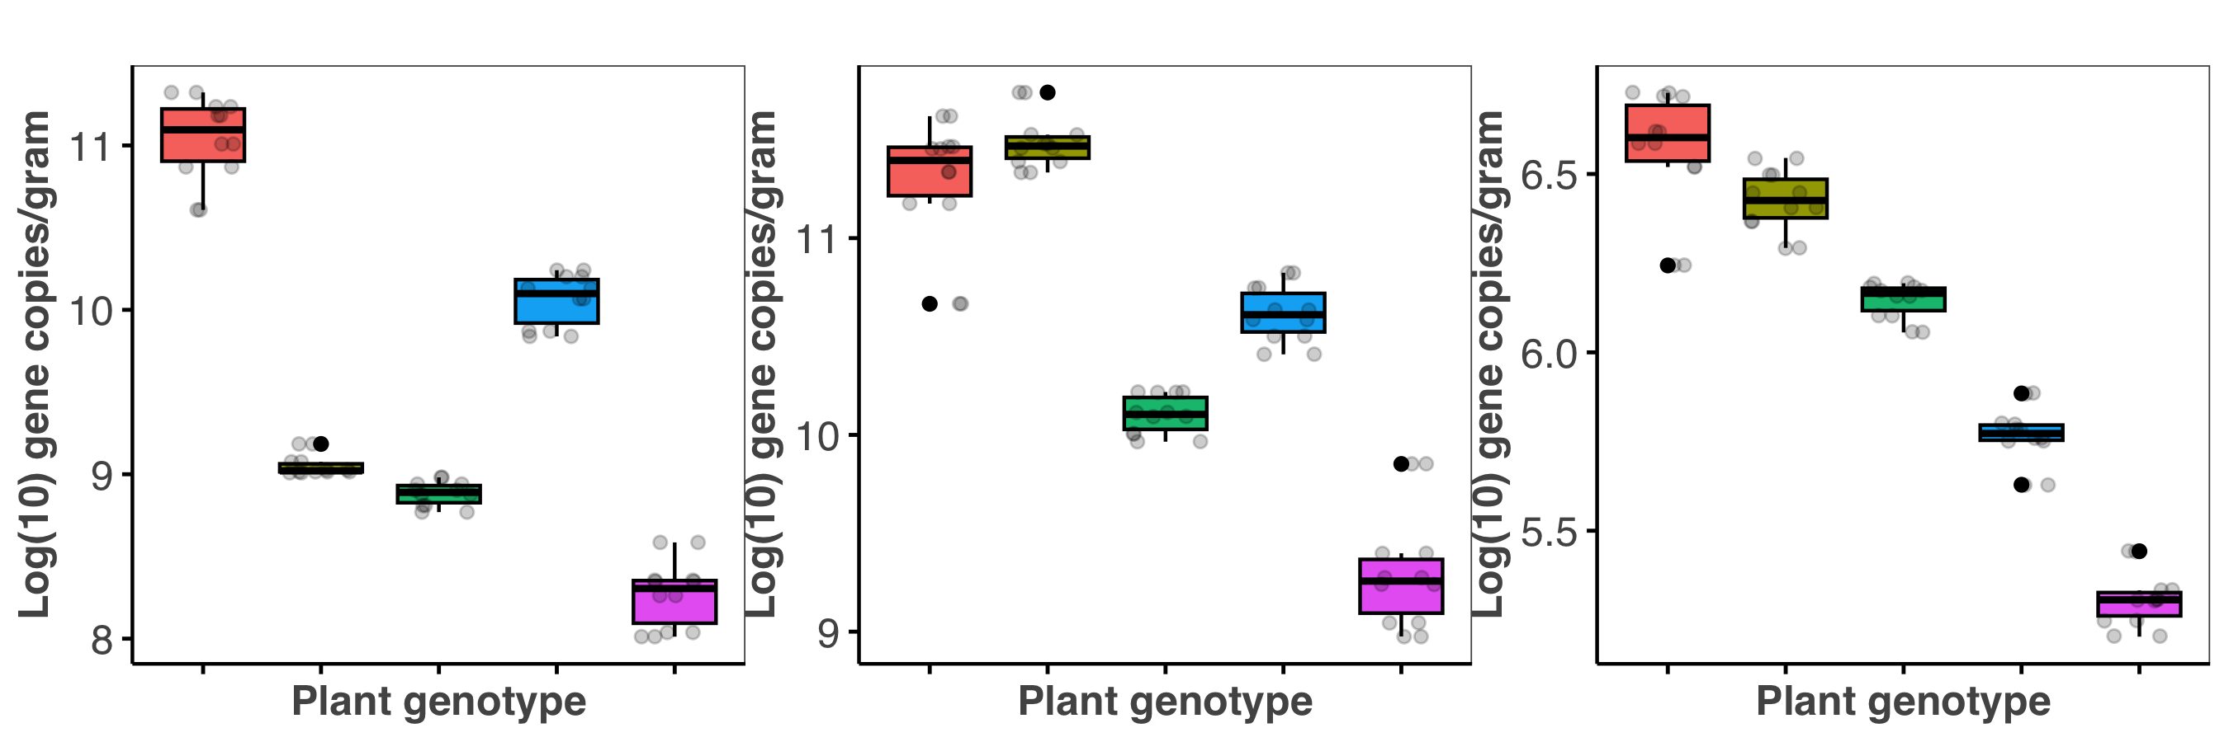
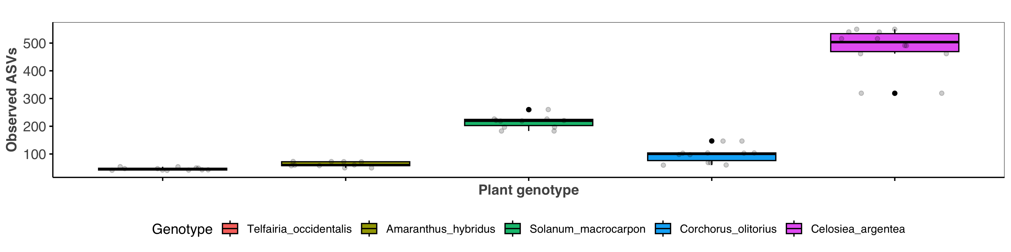
A
Bacterial community
E
Fungal community
I
Archaeal community
Richness
Richness
Richness
B
KW: p= 2.905e-05
c
F
KW: p= 0.04
b
J
KW: p= 0.496
a
a
a
ac
a
ab
ab
a
abc
a
a
b
ab
C
KW: p= 2.905e-05
a
G
KW: p= 0.02
a
K
a
a
KW: p= 0.496
ac
ab
abc
a
a
bc
a
abc
c
bc
b
D
c
KW: p= 1.325e-05
H
ac
a
KW: p= 0.001
L
b
KW: p= 2.905e-05
ab
bc
abc
abc
bc
ac
abc
ab
b
a
c
Telfairia occidentalis
Amaranthus hybridus
Solanum macrocarpon
Corchorus olitorius
Celosiea argentea

Slide 2
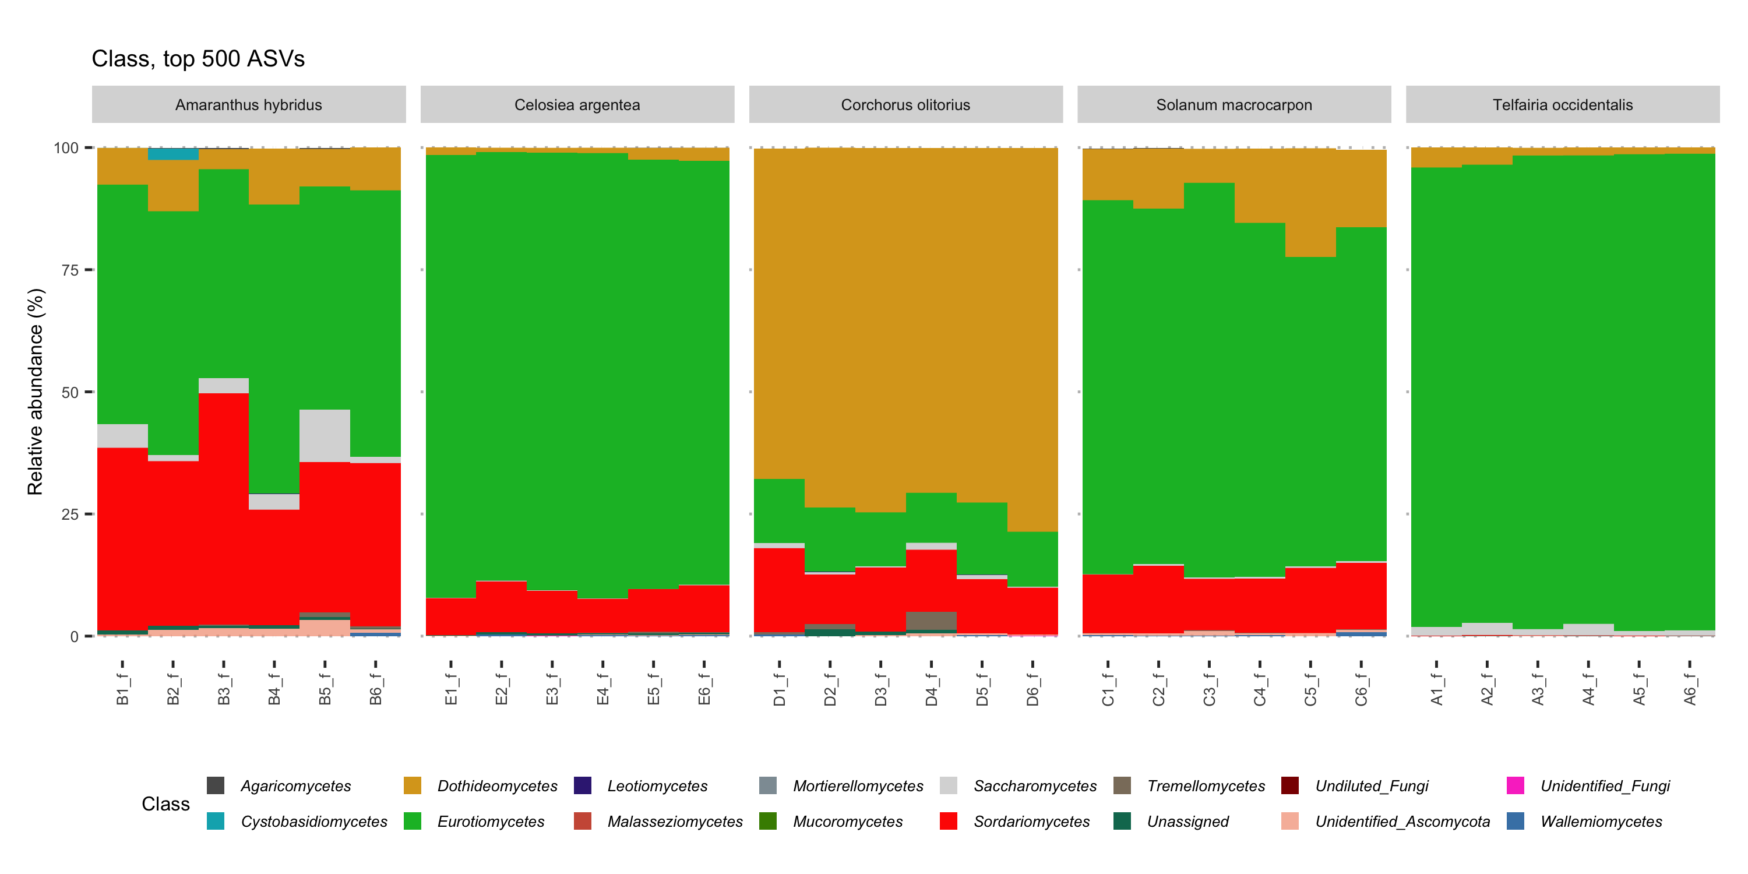
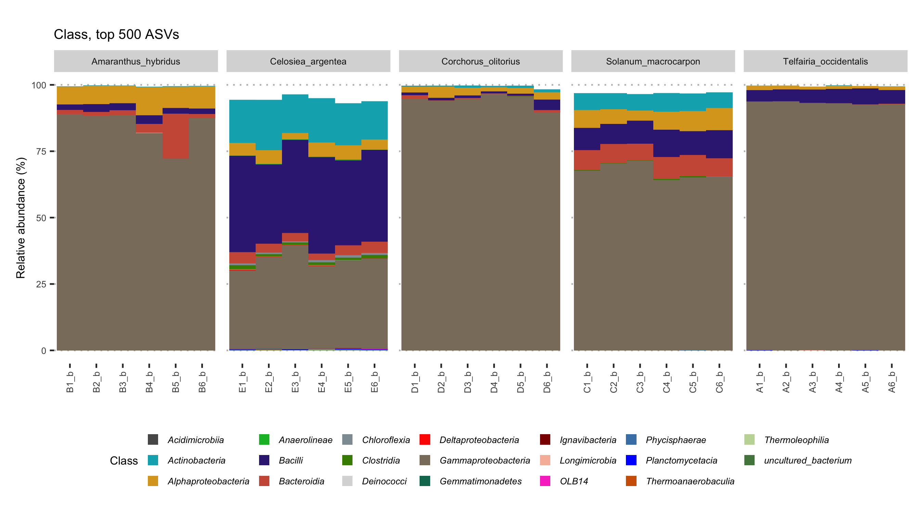
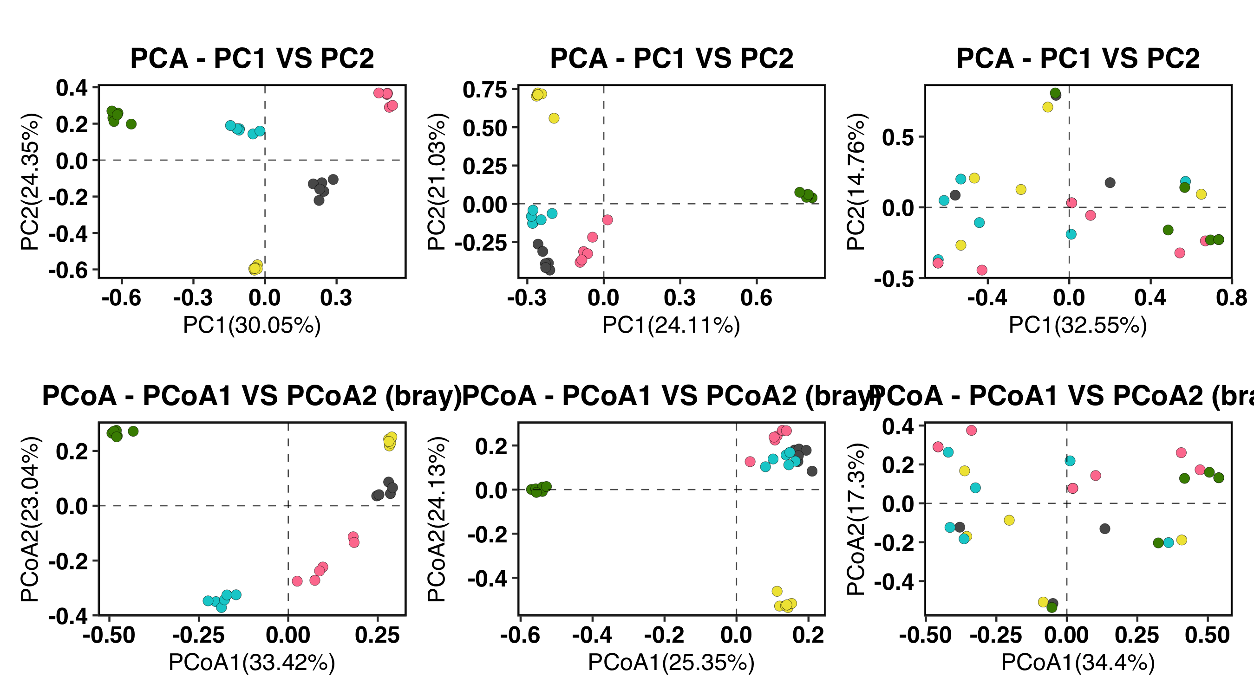
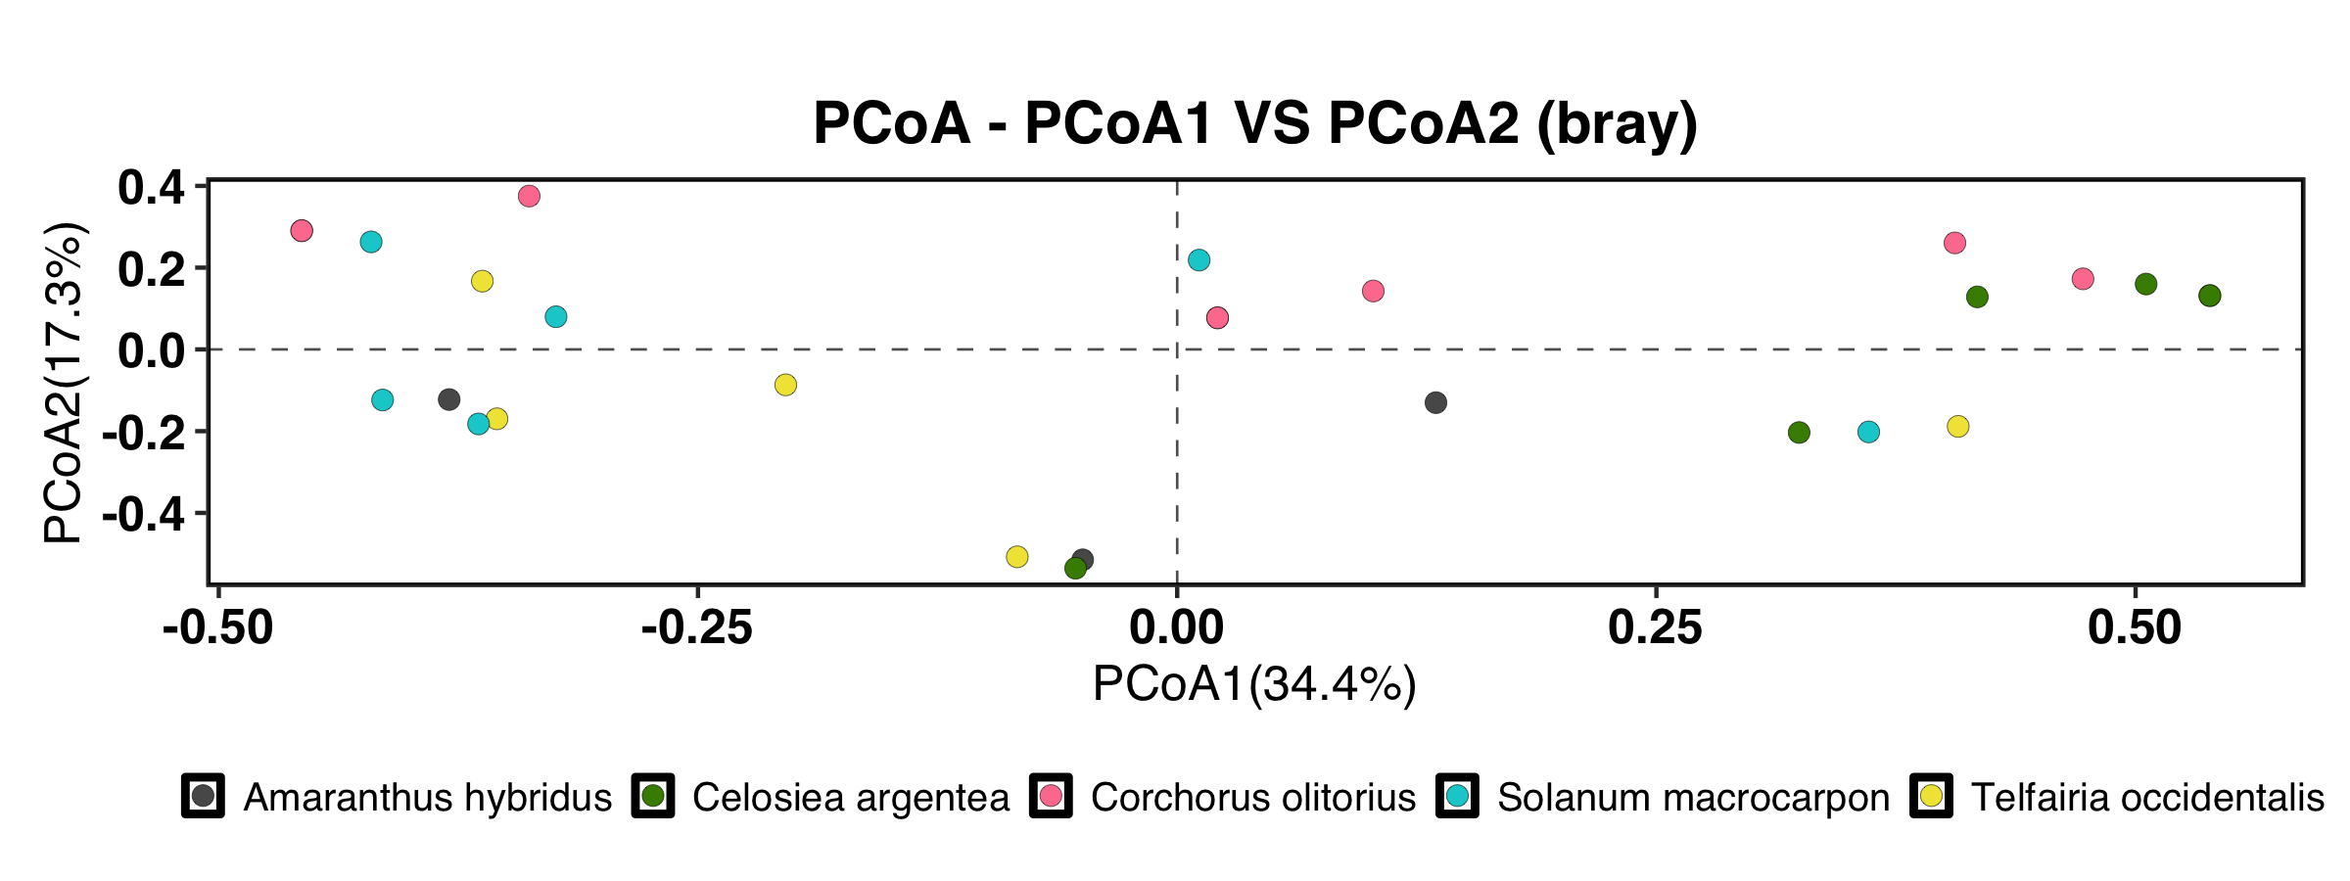
A
Amaranthus hybridus
Celosiea argentea
Corchorus olitorius
Solanum macrocarpon
Telfairia occidentalis
Samples
B
Amaranthus hybridus
Celosiea argentea
Corchorus olitorius
Solanum macrocarpon
Telfairia occidentalis
Samples
C
BACTERIAL COMMUNITY
E
FUNGAL COMMUNITY
G
ARCHAEL COMMUNITY
D
F
H
R²=0.85,
p=0.001
R²=0.76,
p=0.001
R²=0.24,
p=0.012
Amaranthus hybridus
Celosiea argentea
Corchorus olitorius
Solanum macrocarpon
Telfairia occidentalis

Slide 3
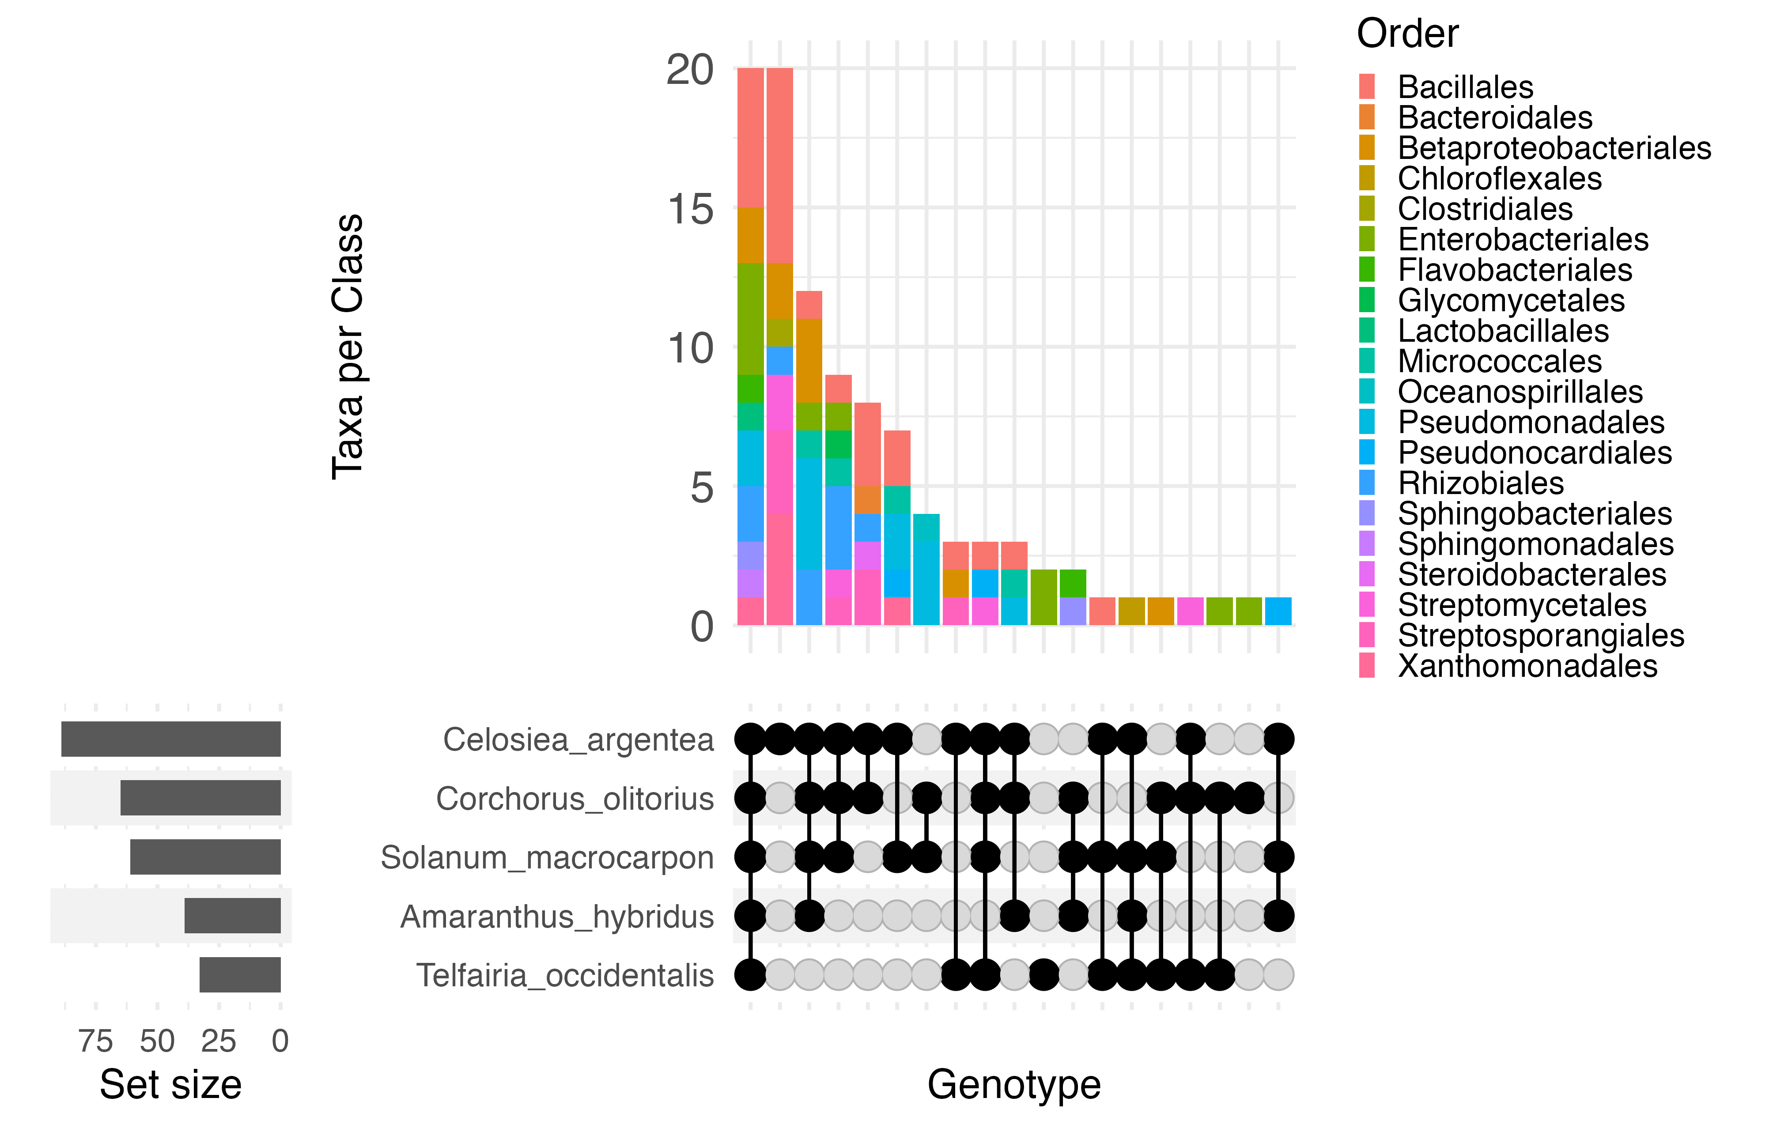
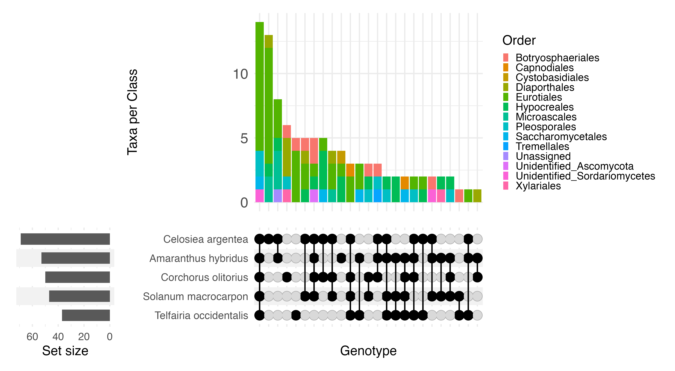
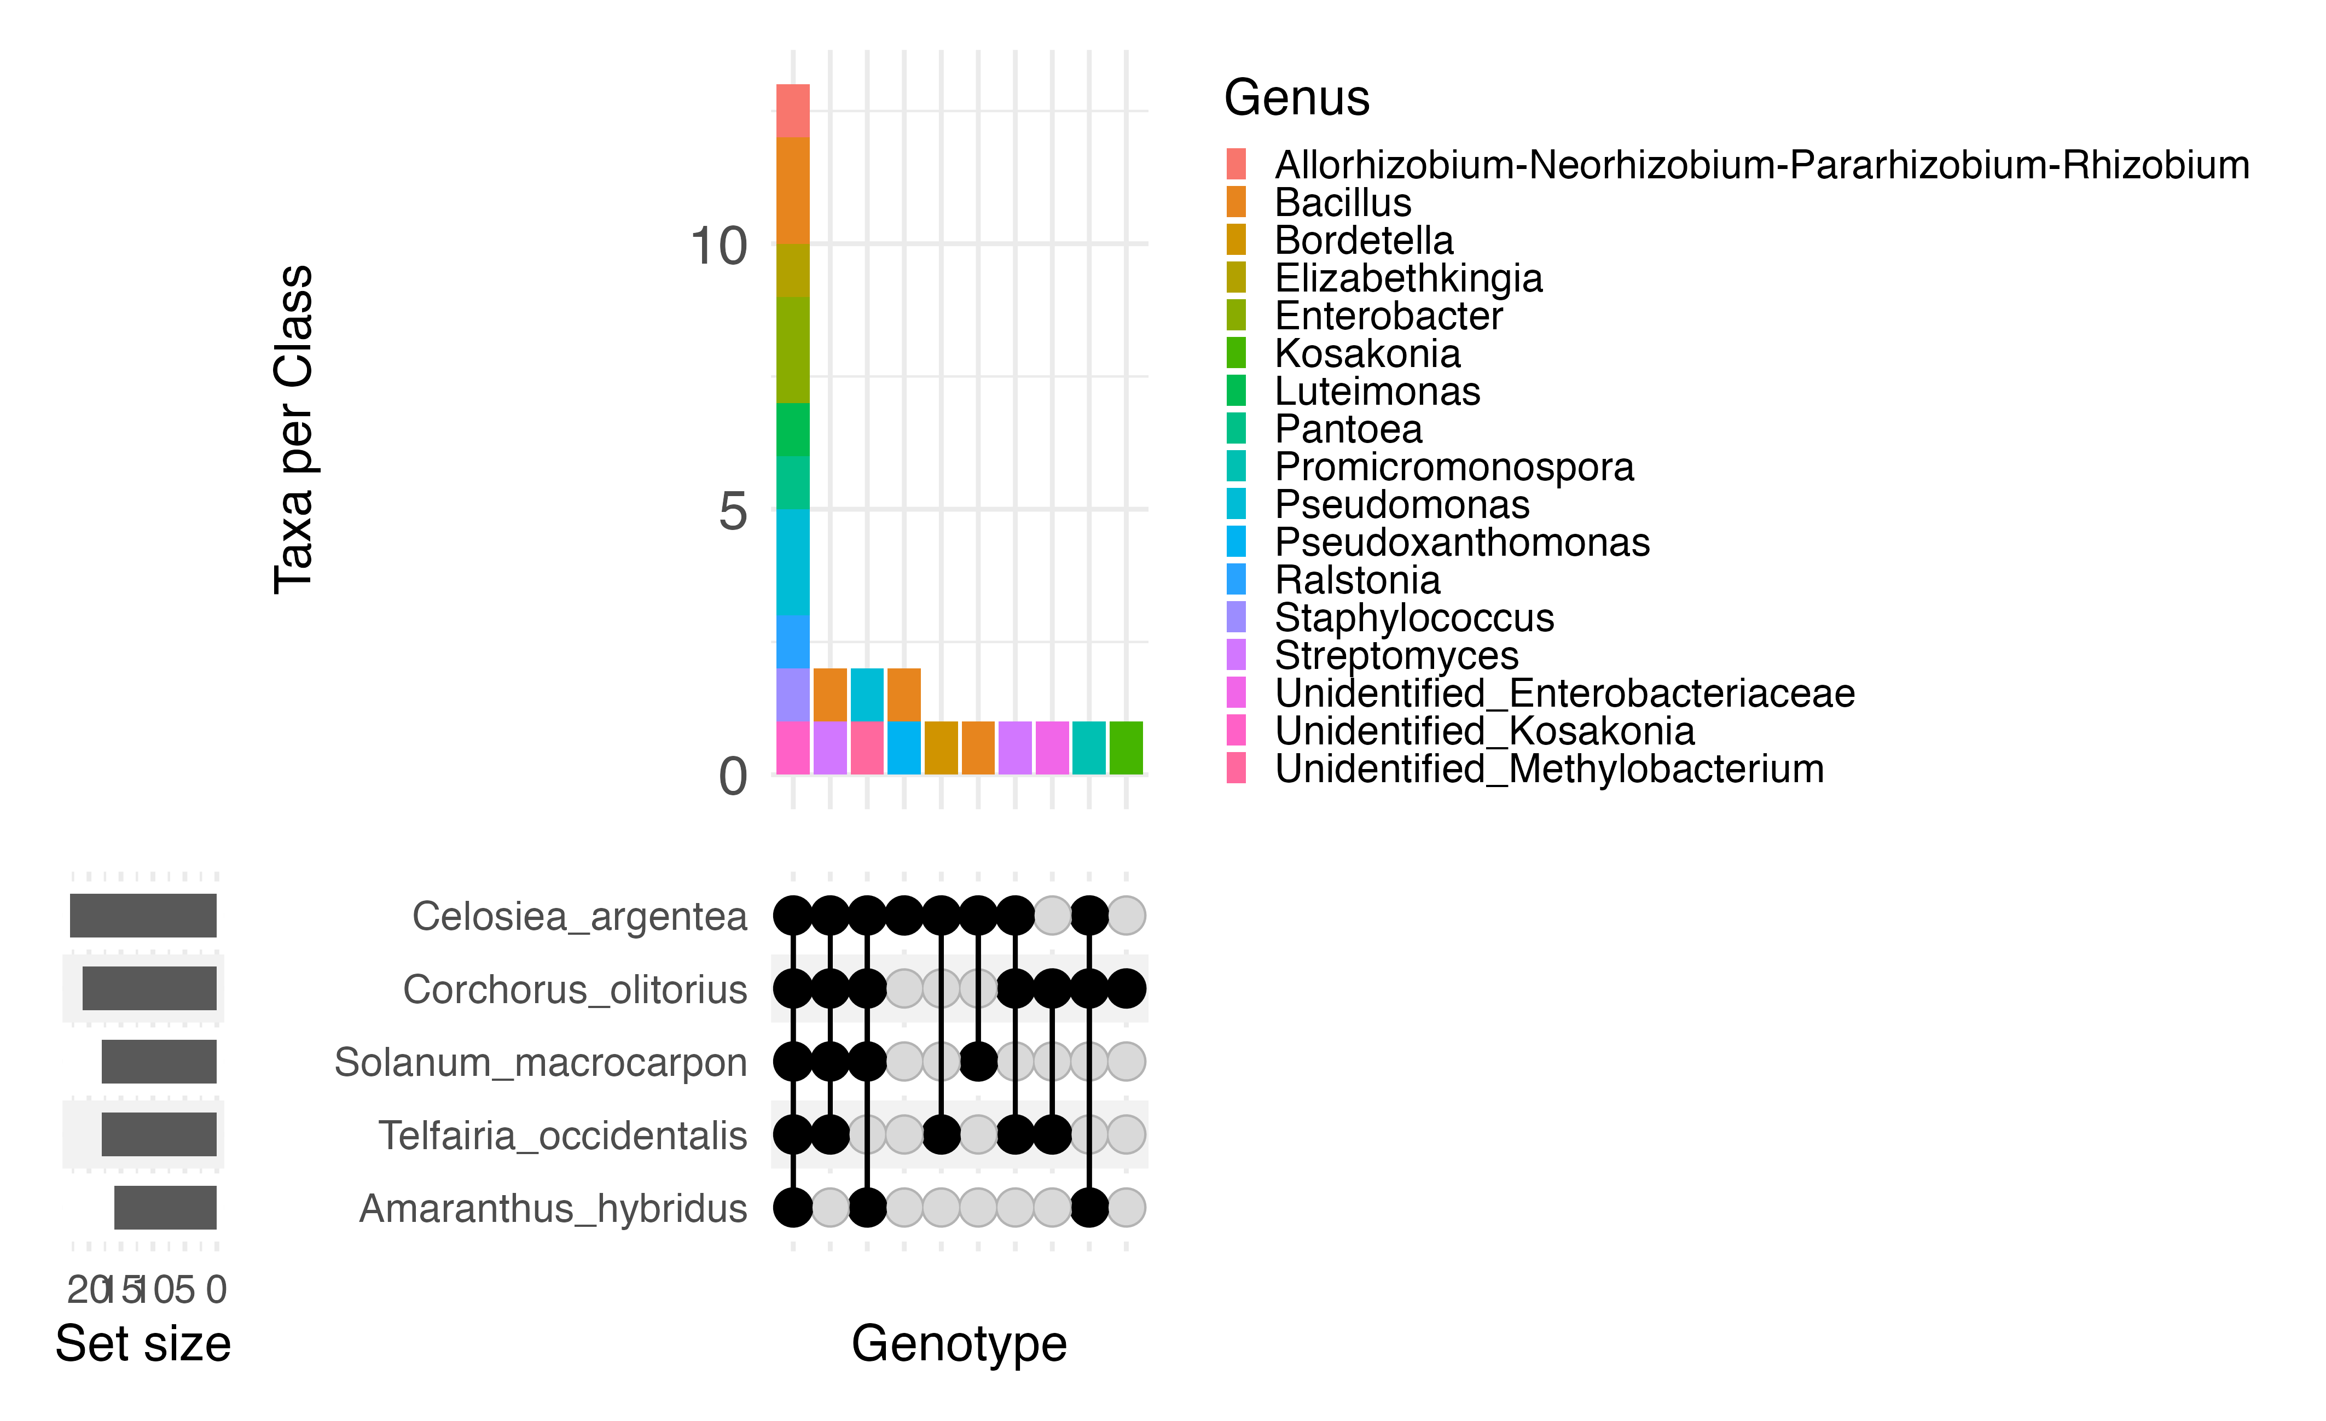
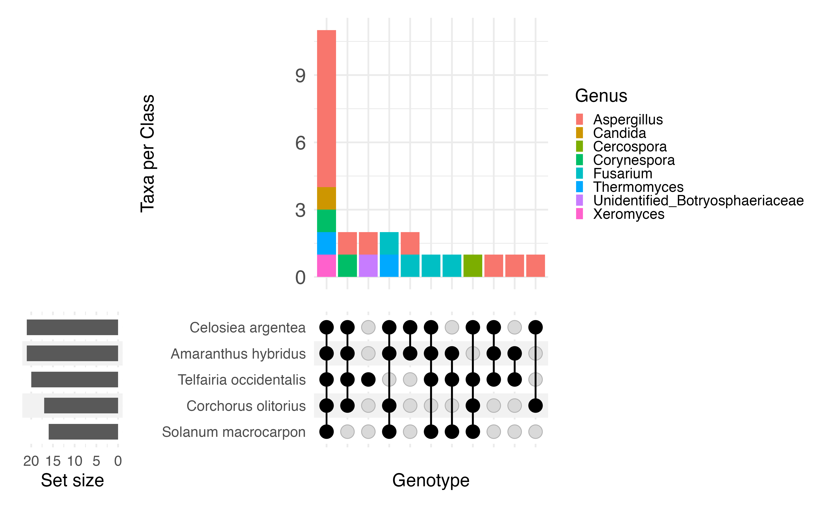
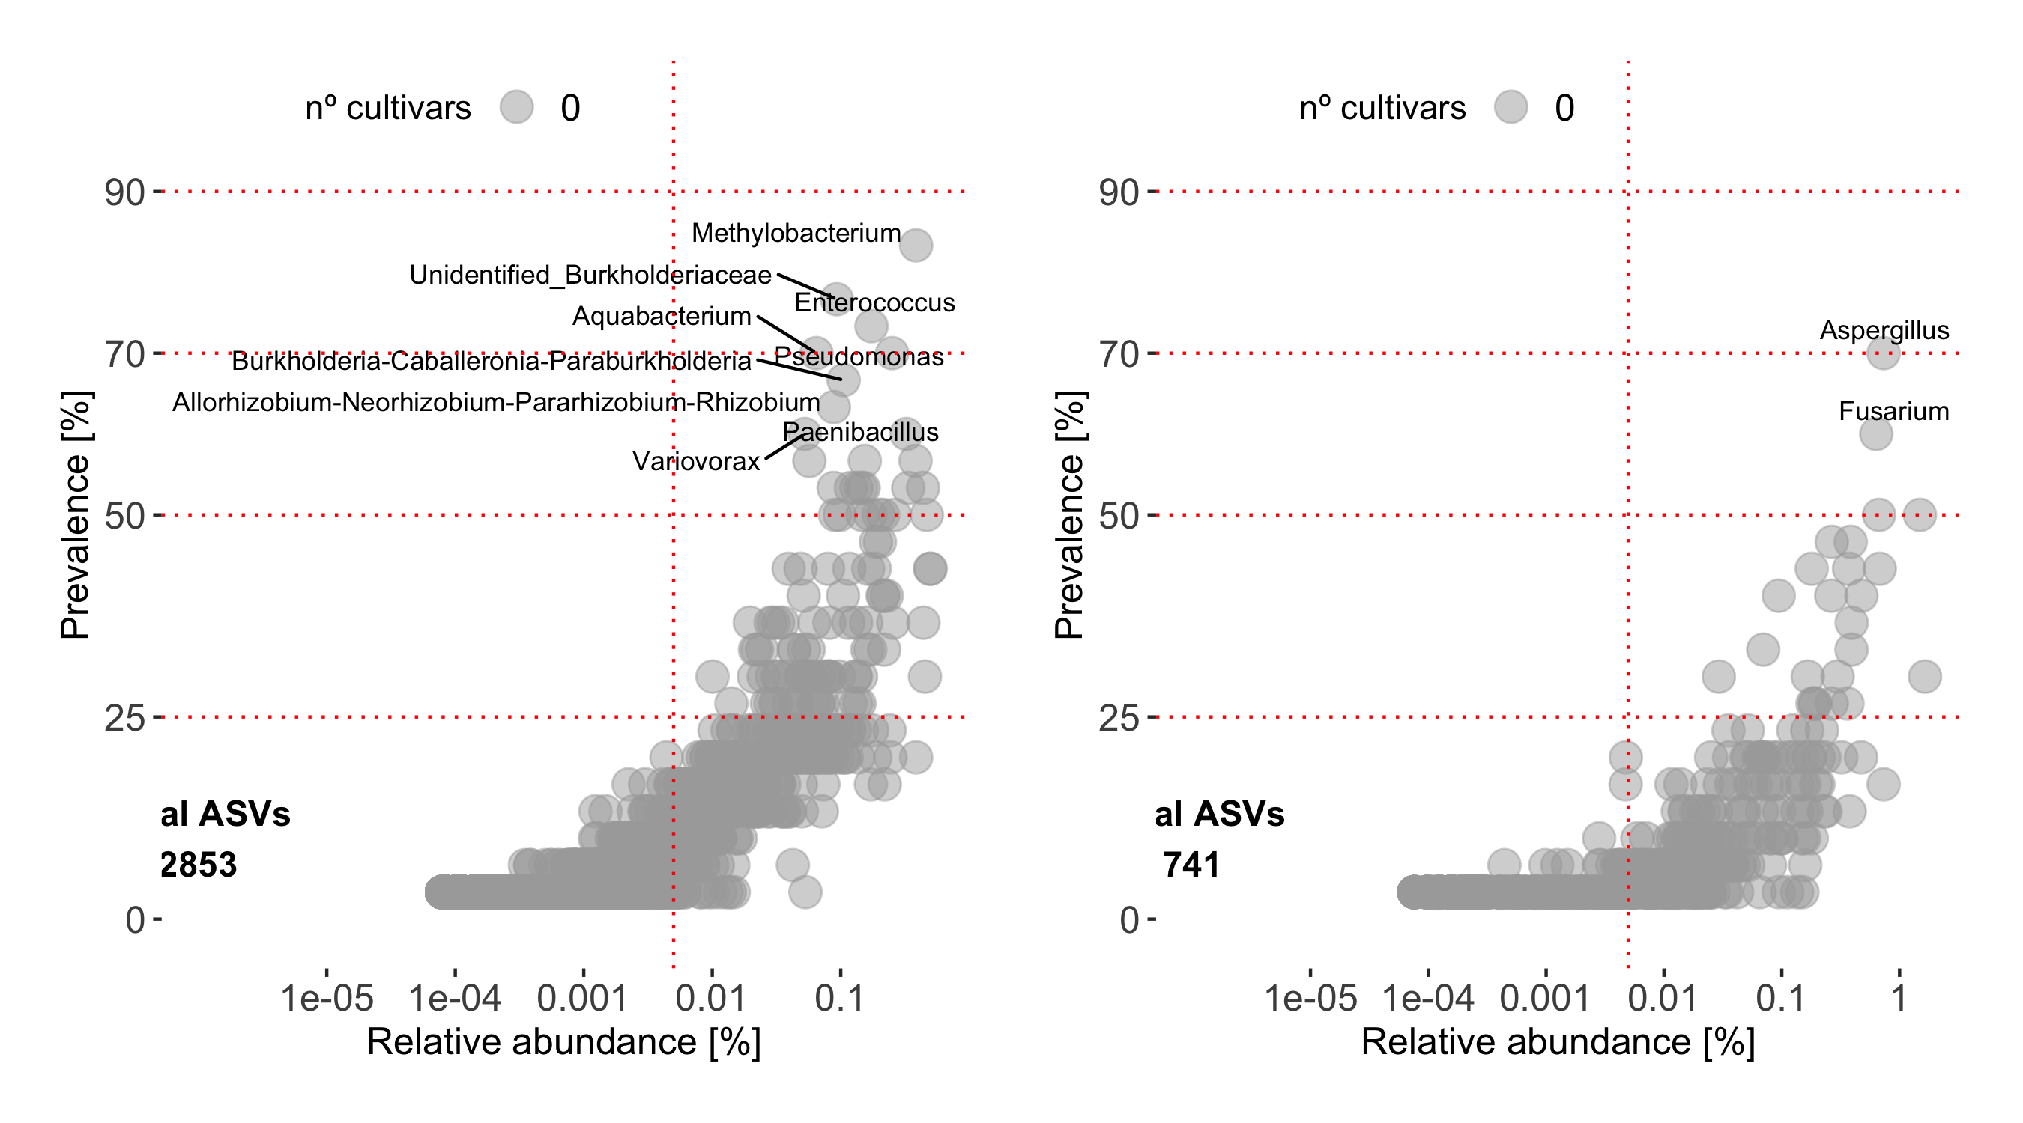

BACTERIAL COMMUNITY
D
A
FUNGAL COMMUNITY
Orders
Orders
Taxa per Class
Taxa per Class
Celosiea argentea
Celosiea argentea
Corchorus olitorus
Corchorus olitorus
Solanum macrocarpon
Solanum macrocarpon
Amaranthus hybridus
Amaranthus hybridus
Telfairia occidentalis
Telfairia occidentalis
Genotypes
Genotypes
B
Genera
E
Genera
Taxa per Class
Taxa per Class
Celosiea argentea
Celosiea argentea
Corchorus olitorus
Amaranthus hybridus
Solanum macrocarpon
Telfairia occidentalis
Telfairia occidentalis
Corchorus olitorus
Amaranthus hybridus
Solanum macrocarpon
Genotypes
Genotypes
C
n°
genotypes
25
50
75
100
F
n°
genotypes
25
50
75
100
Total ASVs
2853
Total ASVs
741
Total ASVs

Slide 4
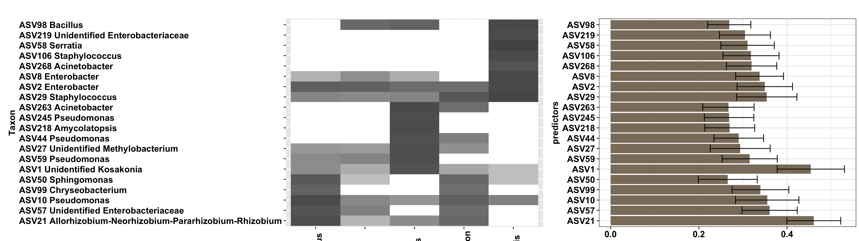
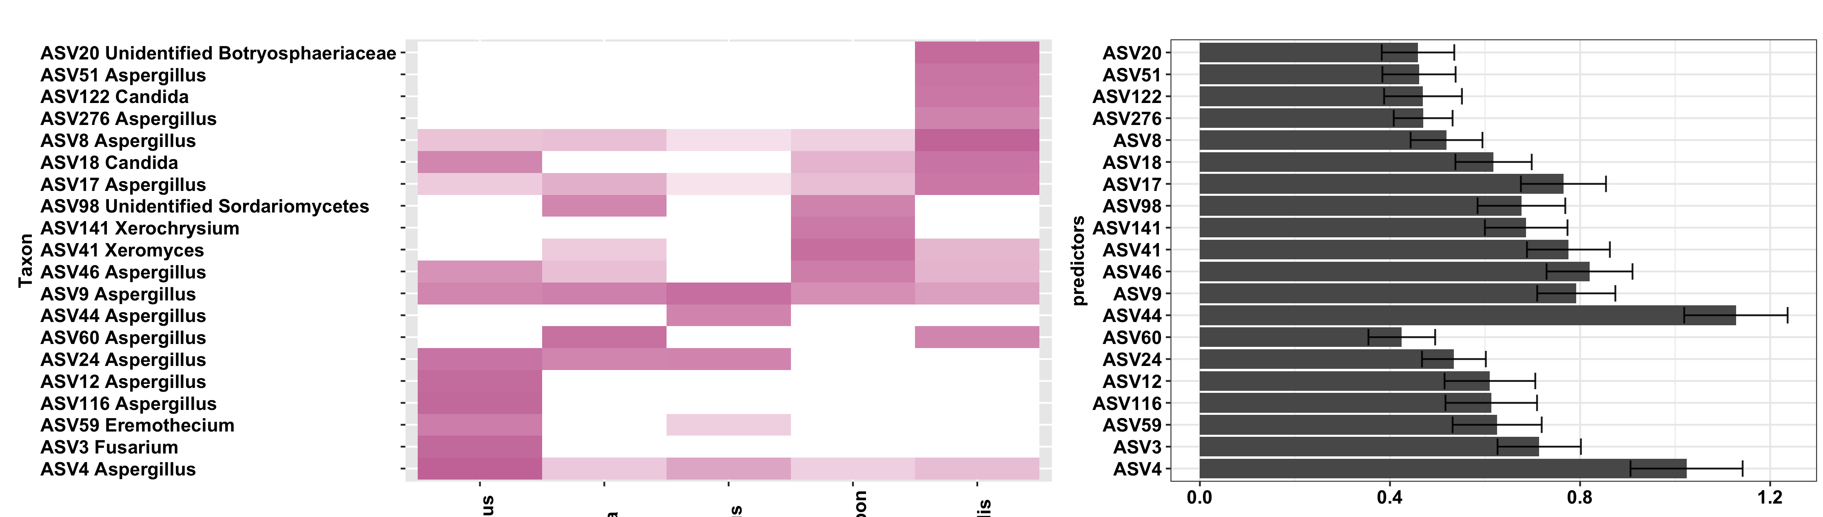
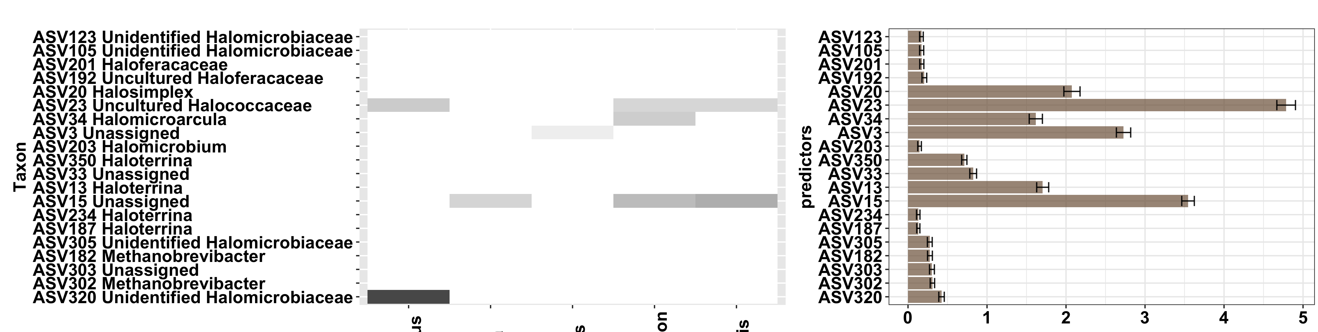
A
Taxa
Genotypes
Bootstrap Mean ± SD Gini Index
B
Taxa
Genotypes
Bootstrap Mean ± SD Gini Index
C
Taxa
Genotypes
Bootstrap Mean ± SD Gini Index
Amaranthus hybridus
Celosiea argentea
Corchorus olitorius
Solanum macrocarpon
Telfairia occidentalis

Slide 5
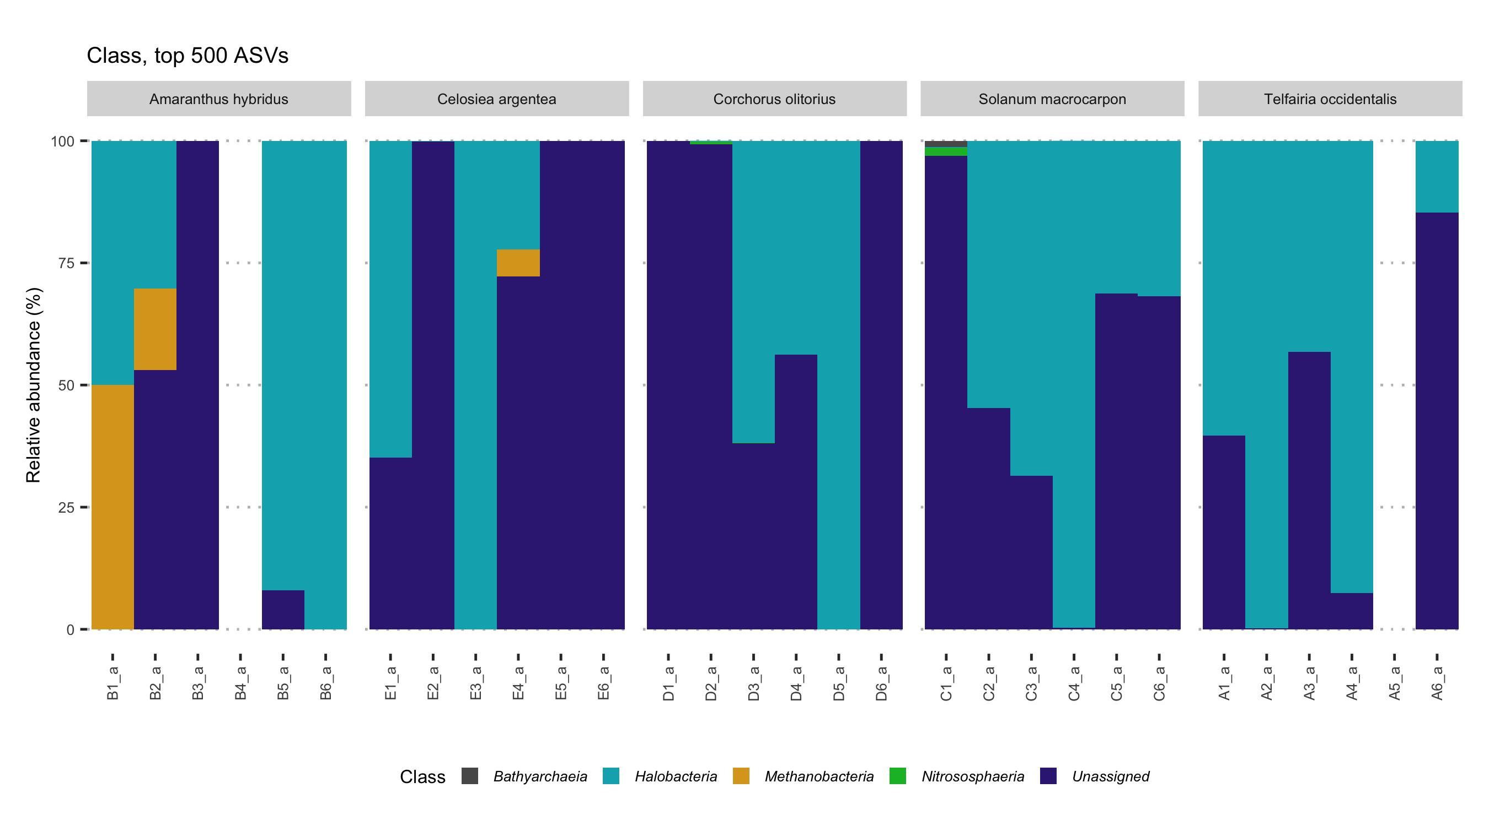
Amaranthus hybridus
Celosiea argentea
Corchorus olitorius
Solanum macrocarpon
Telfairia occidentalis
Samples

